Slide 1
Genetics Bootcamp: CRISPR screens in mammalian cells
Baylee Russell and Nolan Maier
2025 Genetics Bootcamp

Slide 2
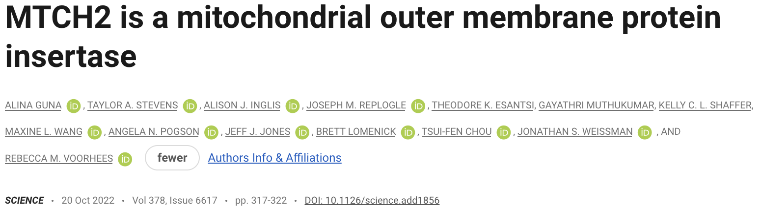

Slide 3
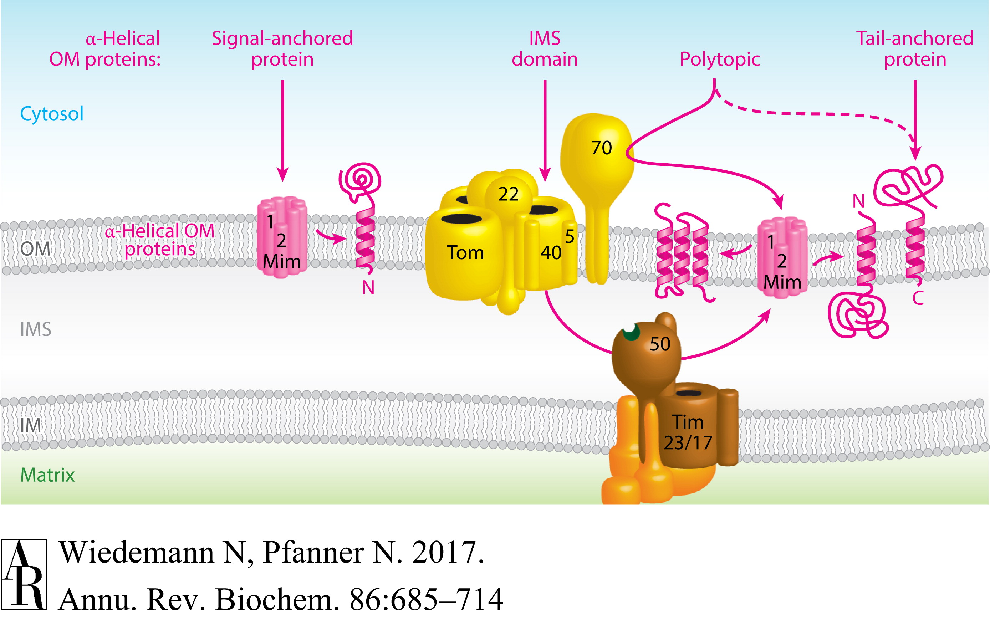
How a-helical proteins are inserted into the outer mitochondrial membrane is not well understood

Slide 4
What is the major question this paper wants to answer?
“We set out to systematically identify and characterize the factors required for mitochondrial TA biogenesis in human cells.”

Slide 5
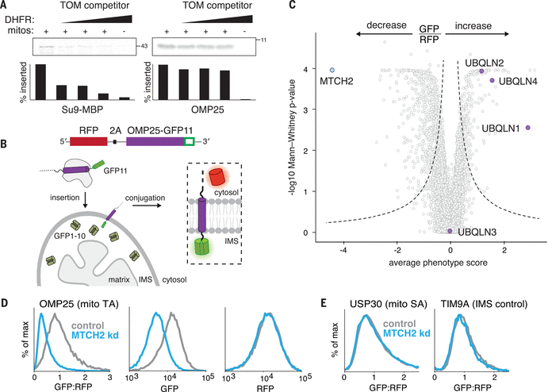
What are the advantages/disadvantages of this reporter design?
Advantages
- Dual fluorescence enables normalization for protein translation
- split-GFP ensures signal only occurs when OMP25 is properly inserted
- 2A and GFP11 are small tags with reduced chance of affecting OMP25 localization
Disadvantages
Split-system requires multiple rounds of genetic engineering
or requires coloniality and lots of screening
Figure 1

Slide 6
What controls are important to perform before screening?
The GFP signal must be as specific as possible!
Figure 1

Slide 7
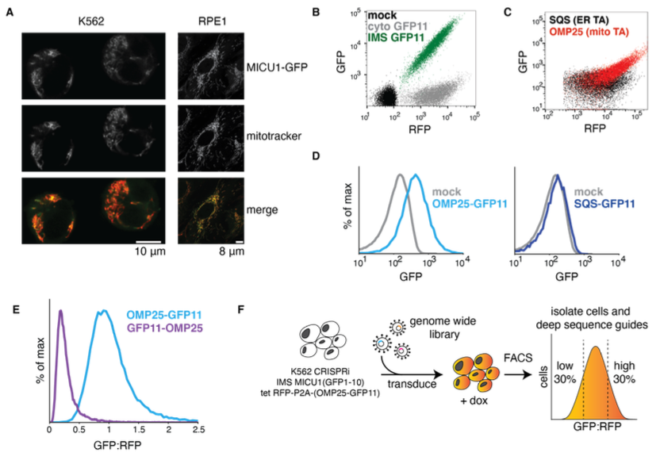
The GFP signal must be specific
GFP1-10 is correctly localized to the mitochondria
No GFP signal from cytosolic or ER localized GFP11
GFP signal only when GFP11 is on the correct side of the outer membrane
Figure S3

Slide 8
Screen design
Figure S3

Slide 9
A genome-wide pooled screens requires hundreds of millions of cells
This is a lot!
# genes
20,000
# sgRNAs per gene
10
# cells per sgRNA
1,000
# cells in the screen
200 Million

Slide 10
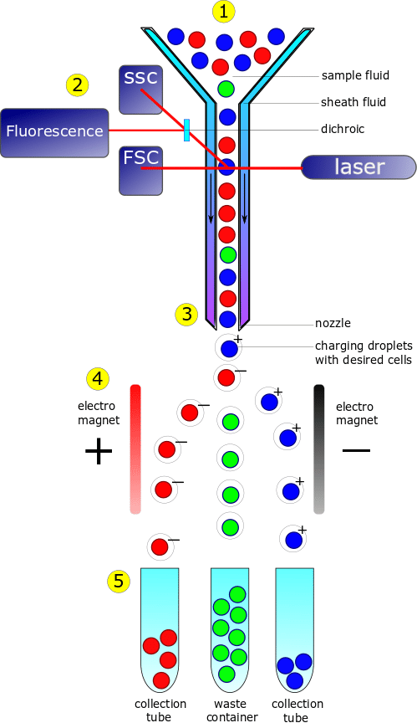
Fluorescence-activated cell sorting (FACS) allows rapid sorting of cells based on fluorescence signal

Slide 11
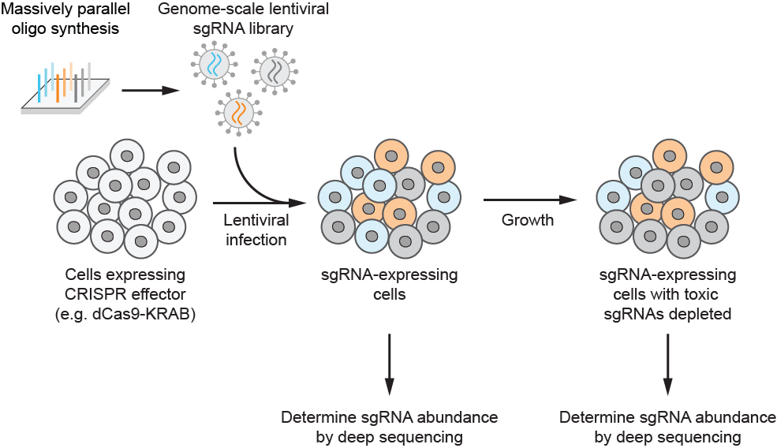
Library prep
Extract genomic DNA
U6 promoter
sgRNA
constant region
other vector elements
U6 promoter
sgRNA
constant region
other vector elements
U6 promoter
sgRNA
constant region
other vector elements
PCR amplify sgRNA cassettes and
append Illumina adapters
Illumina sequencing
(depth = ~0.7-1x screen coverage)
Critical: genomic DNA extraction and PCR need to be efficient to maintain representation

Slide 12
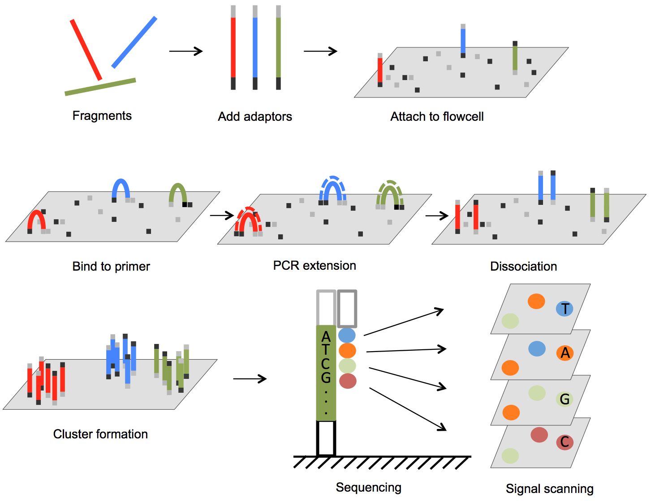
Illumina Sequencing Technology

Slide 13
Data Processing
Sample data can be found at:
github.com/nolanmaier/2024_GeneticsBootcamp

Slide 14
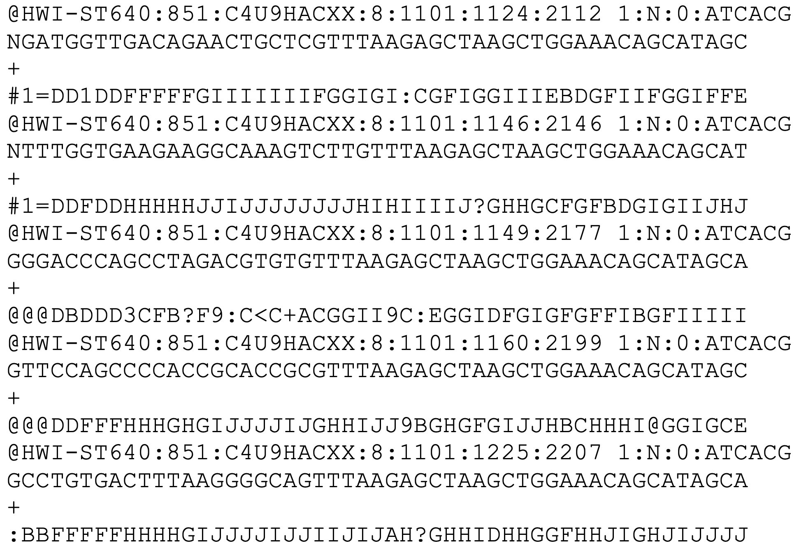
Data Processing Step 1: Convert sequence data to sgRNA counts
Open sample_illumina_data.fastq using a text editor
One entry = one read = one molecule in library
Line 1: sequence id
Line 2: base calls
Line 3: separator
Line 4: quality scores

Slide 15
Data Processing Step 1: Convert sequence data to sgRNA counts
Sequence id
Contents vary by sequencer and software
Usually contains information about the instrument, flow cell, cluster location, and demultiplexing information
Example format for Illumina sequencers
@<instrument>:<run number>:<flowcell ID>:<lane>:<tile>:<x-pos>:<y-pos>:<UMI> <read>:<is filtered>:<control number>:<index>

Slide 16
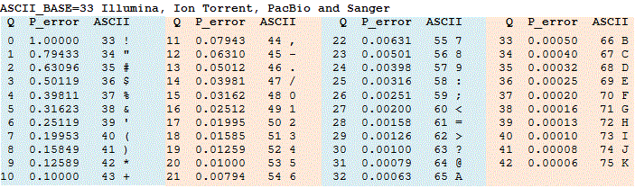
Data Processing Step 1: Convert sequence data to sgRNA counts
Quality scores
ASCII encoded
estimated probability of error

Slide 17
Data Processing Step 1: Convert sequence data to sgRNA counts
U6 promoter
sgRNA
constant region
other vector elements
All sgRNA sequences in sample are known
Use lookup table to find the matching sgRNA ID and gene

Slide 18
Data Processing Step 1: Convert sequence data to sgRNA counts
Try it yourself!
What sgRNAs do the first 5 reads in the FastQ file correspond to?
Use hCRISPRiv2_sgRNA_list.xlsx as your lookup table

Slide 19
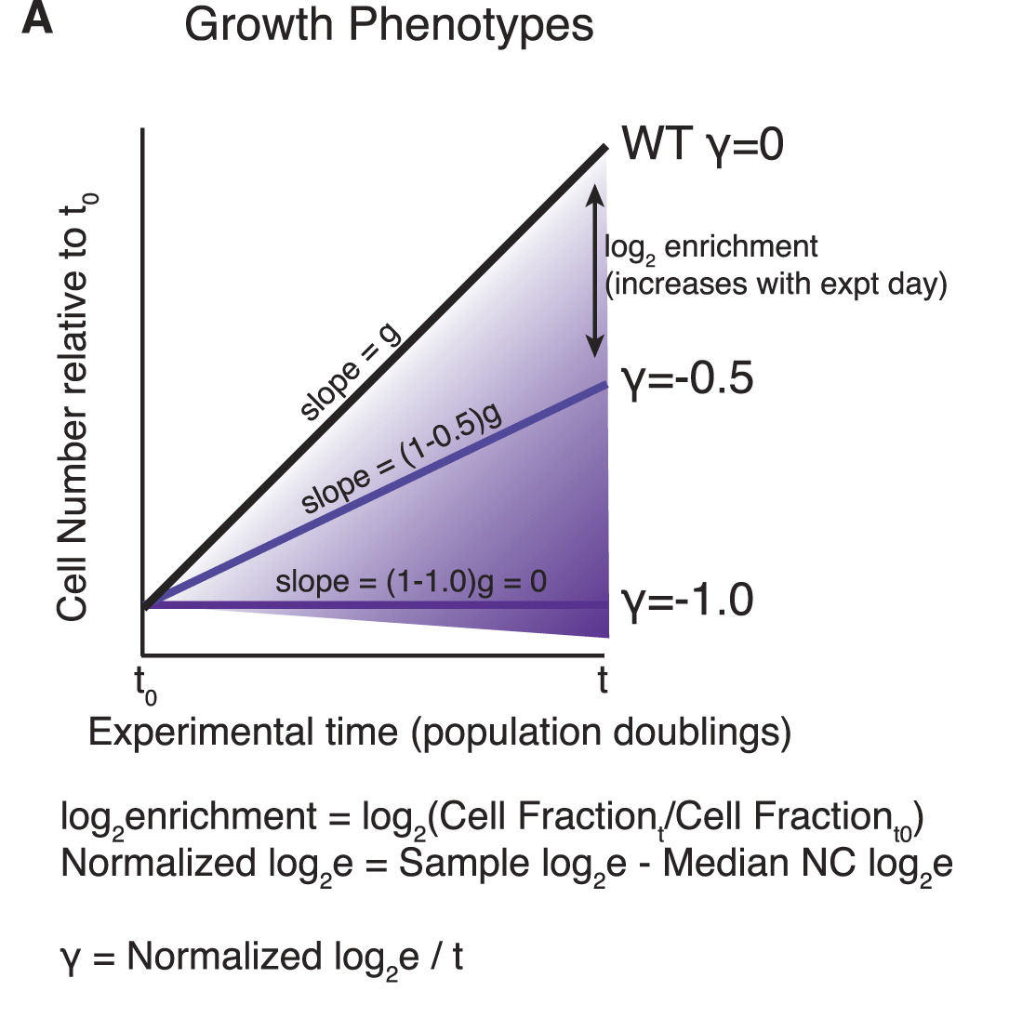
Data Processing Step 2: Calculate sgRNA and gene level phenotypes
sgRNA phenotype score
counts endpoint
sgRNA phenotype = log₂( )
counts start

Slide 20
Data Processing Step 2: Calculate sgRNA and gene level phenotypes
sgRNA phenotype score
counts endpoint
sgRNA phenotype = log₂( )
counts start
Try it yourself!
What are the phenotype scores of the three sgRNAs below?
start
endpoint
sgGeneA GGGCGGCTAGAAGGTGACCG 500
sgGeneB GCTGTCCAGGAGGGGCGTGT 750
sgGeneC GTGCACACGGCAGTAGAAAA 800
sgGeneA GGGCGGCTAGAAGGTGACCG 100
sgGeneB GCTGTCCAGGAGGGGCGTGT 750
sgGeneC GTGCACACGGCAGTAGAAAA 900

Slide 21
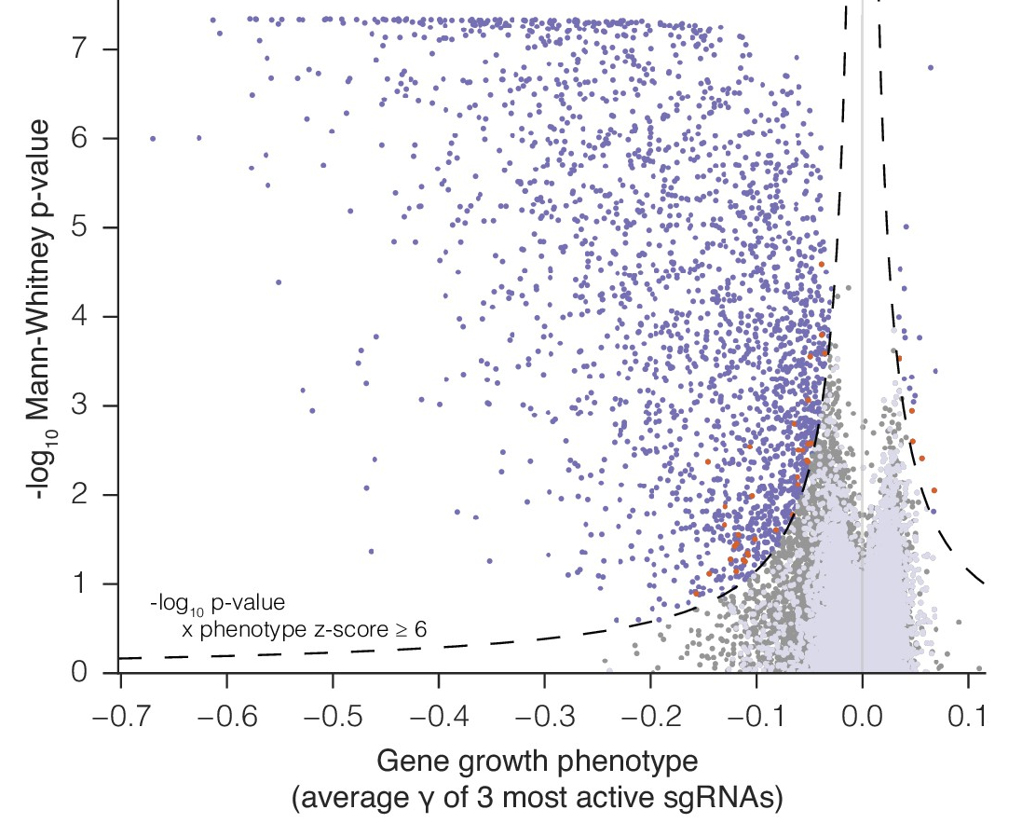
Data Processing Step 2: Calculate sgRNA and gene level phenotypes
gene phenotype score = average of 3 strongest sgRNAs
Mann-Whitney p-value = comparison of gene-specific sgRNA phenotype
vs non-targeting control sgRNA

Slide 22
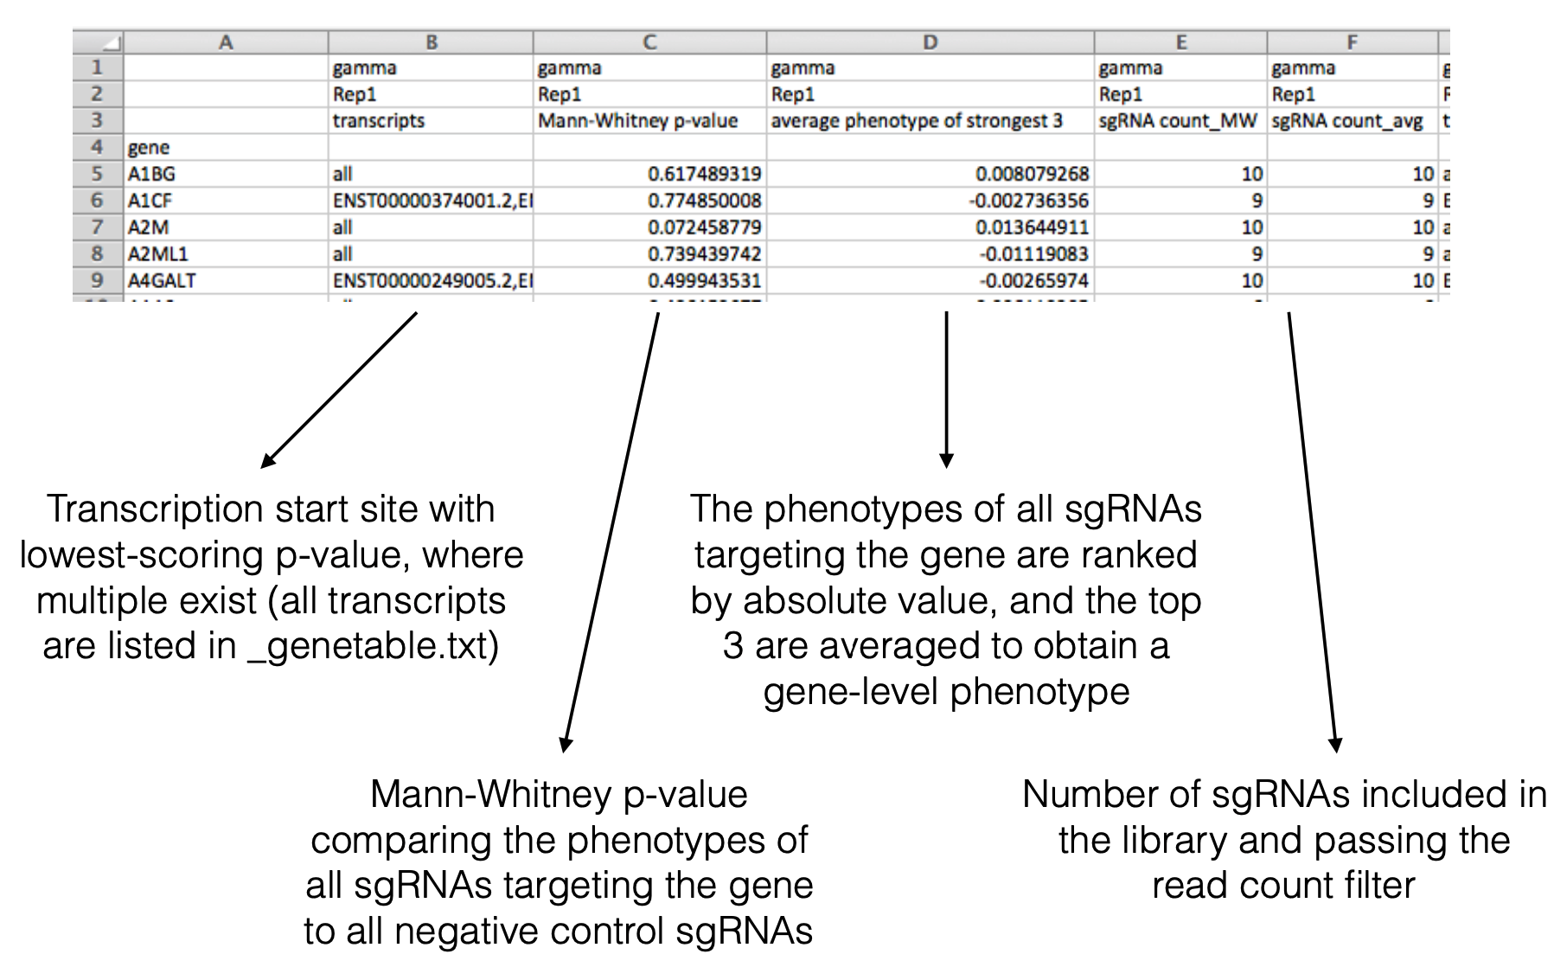
Data Processing Step 2: Calculate sgRNA and gene level phenotypes
Open screendata_growth.csv

Slide 23
Data Processing
No one actually does this by hand.
Many automated scripts exist for processing sgRNA count data.
Example python scripts can be found at:
github.com/mhorlbeck/ScreenProcessing

Slide 24
“We set out to systematically identify and characterize the factors required for mitochondrial TA biogenesis in human cells.”

Slide 25
Volcano plots are helpful for visualizing hits
- Knockdown of ubiquilin chaperones increases GFP signal
- Ubiquilins are known to degrade TA proteins
- Knockdown of MTCH2 decreases GFP signal
- MTCH2 is an outer mitochondrial membrane protein annotated as a transporter of metabolites into the mitochondria, but has no known substrate
Figure 1

Slide 26
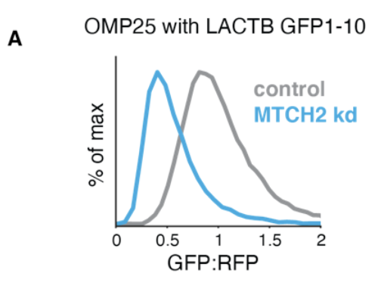
Transducing individual sgRNAs for validation
Validating that knockdown of MTCH2 increases GFP signal
Knockdown of MTCH2 has no effect on global translation
Figure 1
Validating that knockdown of MTCH2 increases GFP signal with an alternative reporter
Figure S6

Slide 27
Conclusion: MTCH2 plays a role in biogenesis of OMP25
Question: What role does MTCH2 play in general mitochondrial protein biogenesis?

Slide 28
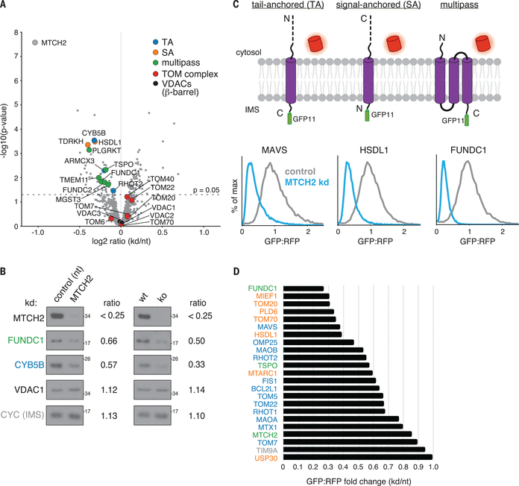
Mass-spectrometry reveals the extent of MTCH2’s effect on mitochondrial outer membrane protein biogenesis
Figure 2

Slide 29
MTCH2 affects the biogenesis of a-helical mitochondrial membrane proteins generally
Figure 2

Slide 30
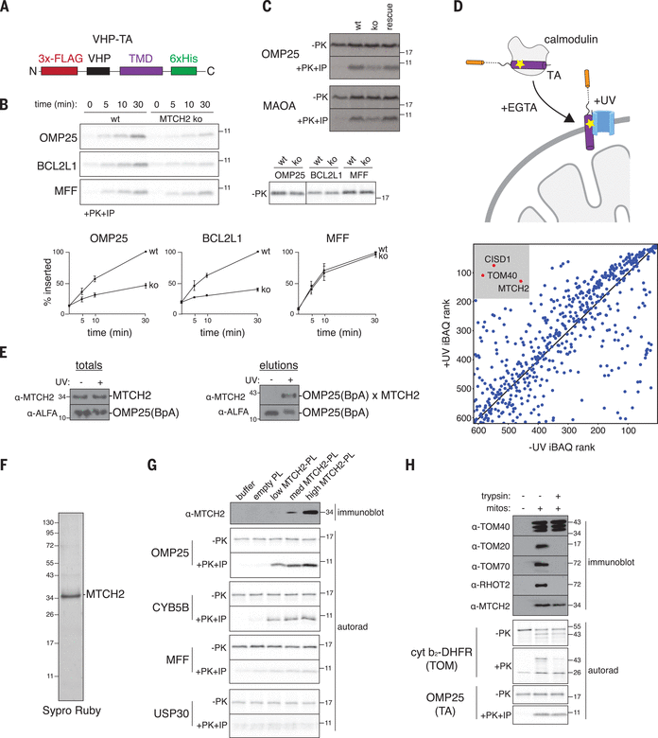
MTCH2 binds and inserts a-helical proteins into membranes in vitro
Figure 3

Slide 31
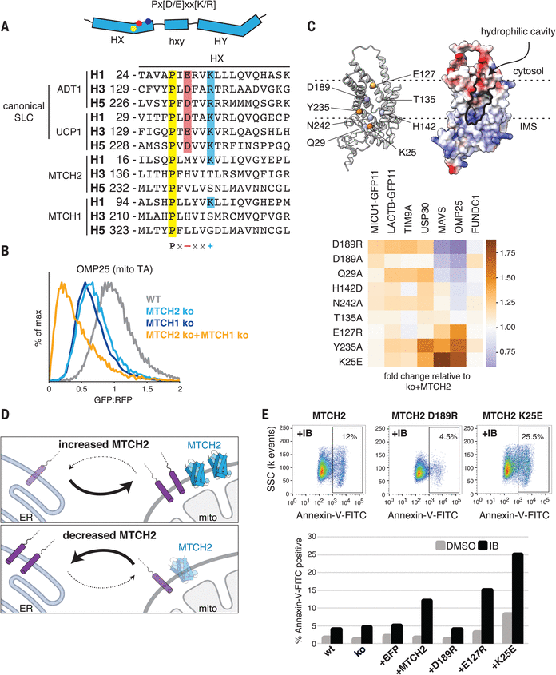
MTCH2 regulates outer membrane function
MTCH2 is the founding member of a novel class of membrane protein insertases
Figure 4

Slide 32
What can we take away about screen design?
Carefully design your selective pressure to answer your biological question
Genome-wide screens are a lot of work with mammal-sized genomes
The screen is only the beginning
Independent hit validation is important
Going from gene hit to cellular function can be a long road

Slide 33
Now let’s analyze a CRISPR screen ourselves!

Slide 34
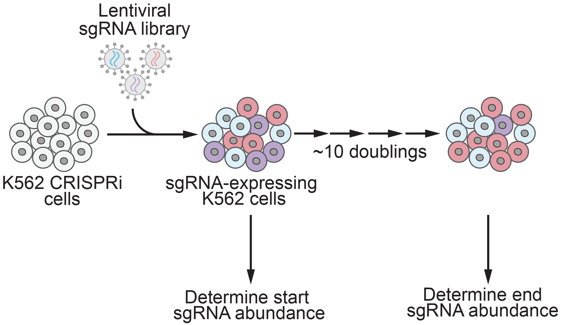
Data Exploration Part 1: Growth screen
Data from: Horlbeck et al., eLife 2016 e19760

Slide 35
Data Exploration Part 1: Growth screen
Try it yourself!
Open the CRISPR_screen_analysis.ipynb Jupyter notebook
There is a Google Colab link at the bottom of the Github repo:
github.com/nolanmaier/2024_GeneticsBootcamp

Slide 36
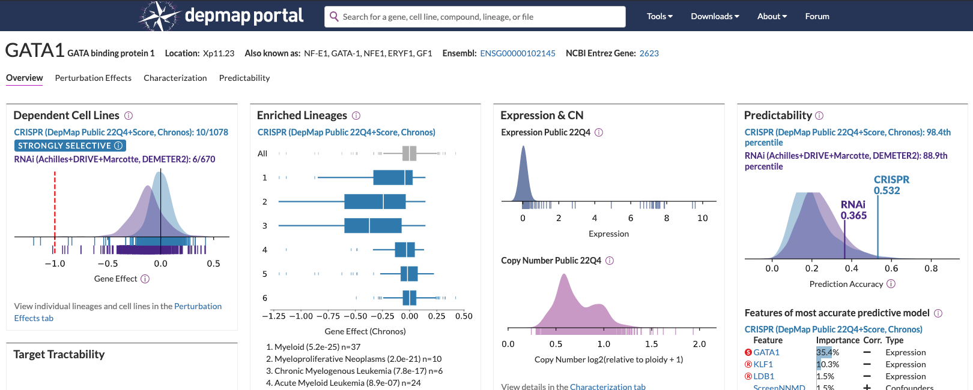
Data Exploration Part 1: Growth screen
Main Takeaways:
Essential genes (e.g. ribosomes) are major hits in growth screens
Comparing essential genes across cell lines can reveal cell-type specific essential genes

Slide 37
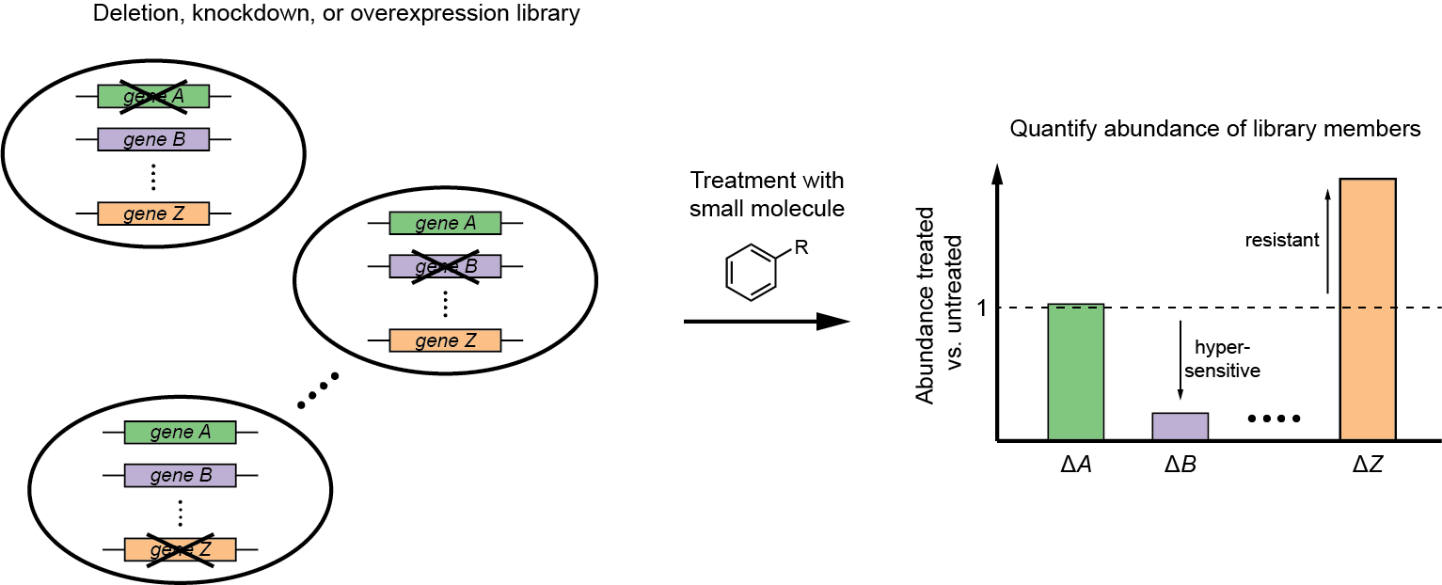
Data Exploration Part 2: Chemical-genetic screen
Chemical-genetic screening = systematic measurements of drug sensitivity of strains with perturbed gene expression (e.g. deletion or overexpression)
putative target
Giaever et al., Nat. Genet. 1999, 21, 647; Lum et al., Cell 2004, 116, 121; and more

Slide 38
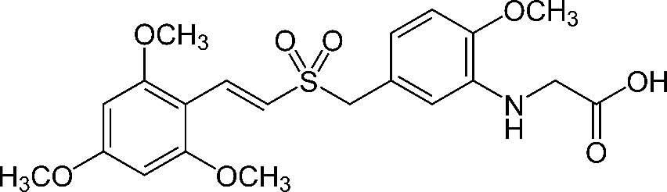
Data Exploration Part 2: Chemical-genetic screen
Rigosertib
(Estybon,
ON 01910.Na)
first reported in 2005, kills many types of cancer cell lines
causes G2/M arrest, apoptosis
was in phase III clinical trials for myelodysplastic syndrome and other cancers
but molecular target and mechanism of action unclear
proposed to inhibit polo-like kinase 1 (PLK1), PI3 kinase, or Ras signaling, but claims are controversial
Gumireddy et al., Cancer Cell 2005, 7, 275; Athuluri-Divakar et al., Cell 2016, 165, 643

Slide 39
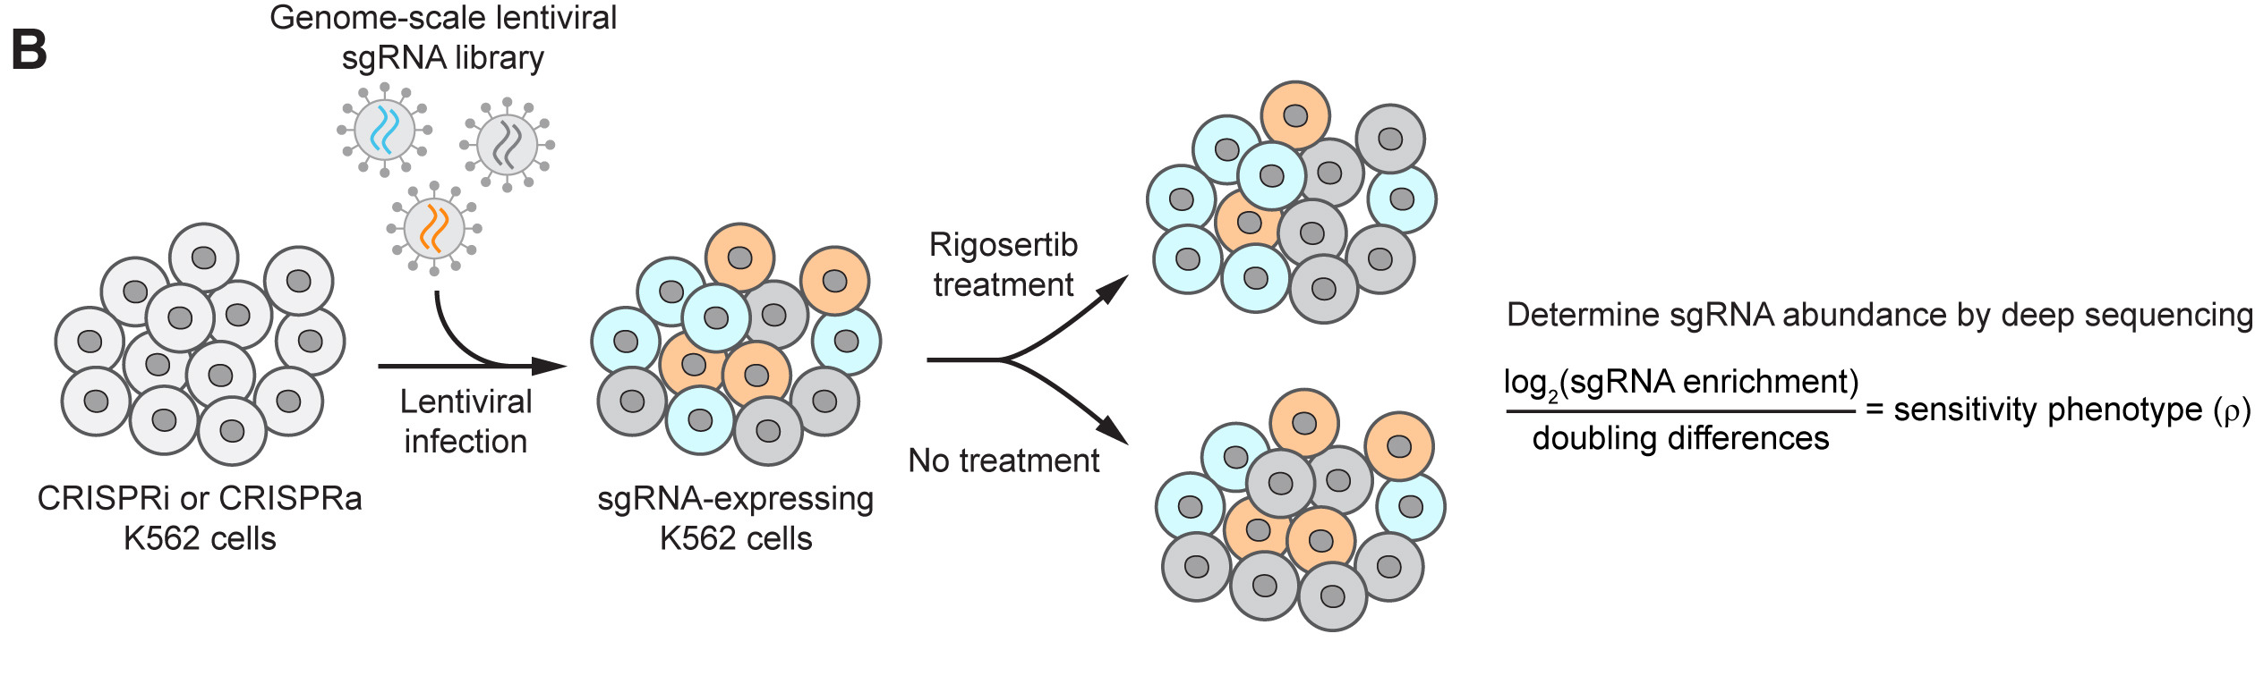
Data Exploration Part 2: Chemical-genetic screen

Slide 40
Data Exploration Part 2: Chemical-genetic screen
Try it yourself!
Open the CRISPR_screen_analysis.ipynb Jupyter notebook
There is a Google Colab link at the bottom of the Github repo:
github.com/nolanmaier/2024_GeneticsBootcamp

Slide 41
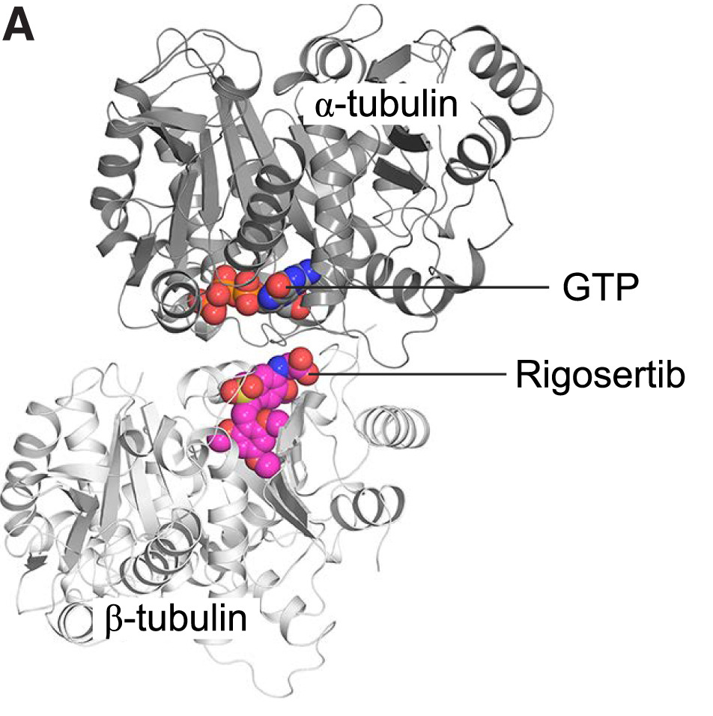
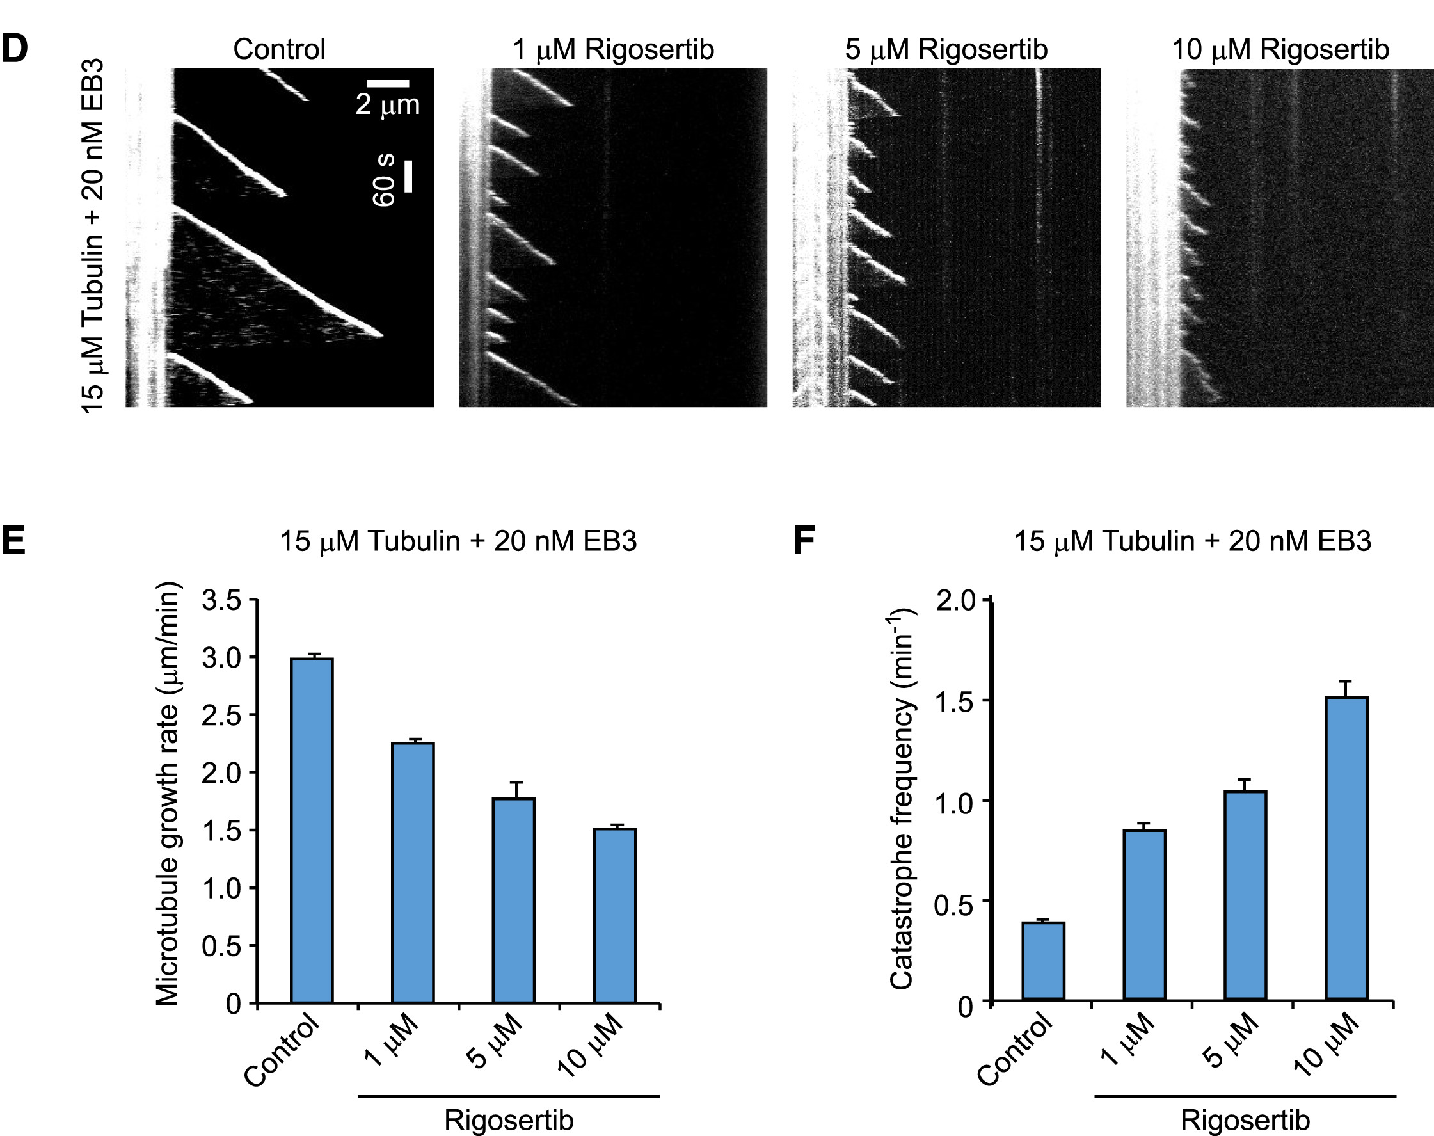
Validation: Rigosertib binds tubulin and affects microtubule dynamics
Data Exploration Part 2: Chemical-genetic screen
Data from: Jost & Chen et al., Molecular Cell 2017 68:1

Slide 42
Data Exploration Part 2: Chemical-genetic screen
Main Takeaways:
Genetic screens are hypothesis generators
Layering data from multiple screens can narrow down hypotheses
Validation is always necessary to address a particular hypothesis

